Slide 1
UNIX File management
“how to store stuff”

Slide 2

WHY file systems ?
File system
Is a service
an abstract representation
of the secondary storage to the OS

Slide 3
Main memory vs secondary storage
Small (MB/GB)
Expensive
Fast (10⁻⁶/10⁻⁷ sec)
Volatile
Directly accessible by CPU
Interface: (virtual) memory address
“malloc”
Large (GB/TB)
Cheap
Slow (10⁻²/10⁻³ sec)
Persistent
Cannot be directly accessed by CPU
Data should be first brought into the main memory
“open”

Slide 4
WHY file systems ?
A virtual file system
provides the interface
between the data representation
by the kernel
(/dev/sda)
to the user process and the data presentation
to the kernel in memory.
(/home/user/myfile)
Because of the performance disparity between disk and CPU/memory, file system performance is the paramount issue for any OS

Slide 5

Physical storages
File system always acts the same, regardless of underlying physical medium
A medium is mapped unto a file location
The power of /etc/fstab (or /etc/vfstab or similar)

Slide 6
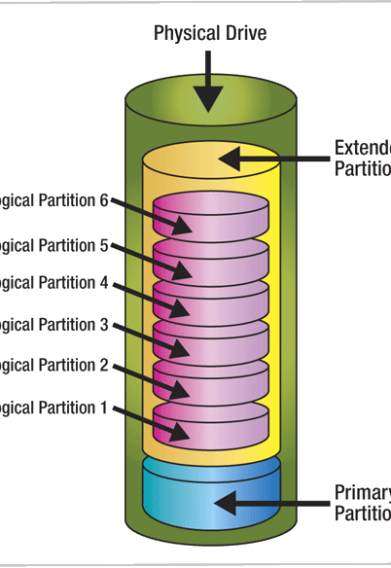
Partitioning for dummies
Commands available
fdisk, cfdisk, sfdisk, parted
E.g. /dev/sda
SCSI / SATA physical disc
One disc per letter
So /dev/sdc is the third disc

Slide 7
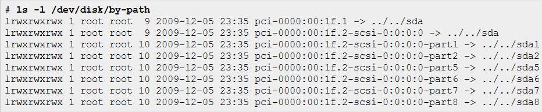

Partitioning for dummies
How can I find out what I have ?
Consult your original hardware documentation
Open up your server ! :D
/dev/disk/by-path
/sys/block

Slide 8
Example partition plan
Partition | Size | Description
/dev/sda1 | 100MB | Will be used to house the /boot partition in which the bootloader configuration and kernel images are stored. Separate partition as none of the files on this partition are needed during regular operations (this partition is not automatically mounted)
/dev/sda2 | 12GB | Main (root) partition which will host the Linux operating system
/dev/sda3 | 27GB | Partition which will hold the /home files (files and folders of the users of the system).
/dev/sda4 | 900MB | Swap partition. The desktop system will have enough physical memory and the system will not use software suspend (write memory content to disk and hibernate the system) so the swap does not need to be as large as the physical memory

Slide 9

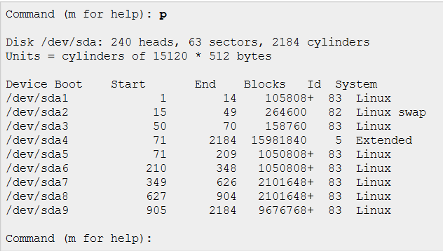
Partitioning in action

Slide 10
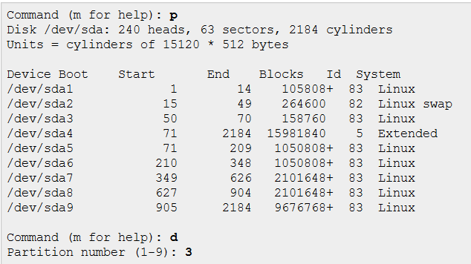

Destroying the old

Slide 11
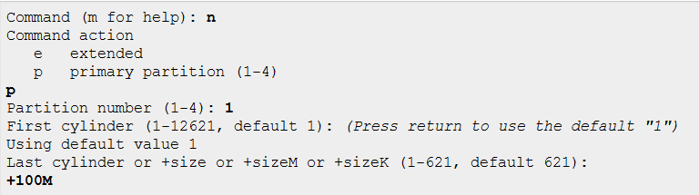
Creating the first partition

Slide 12
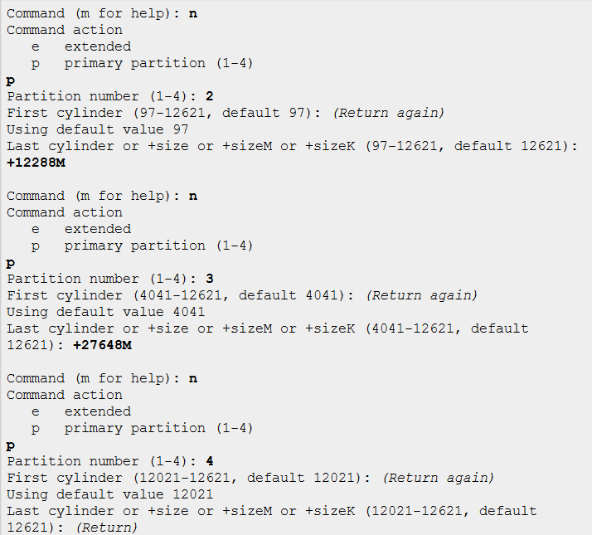
Creating the others

Slide 13
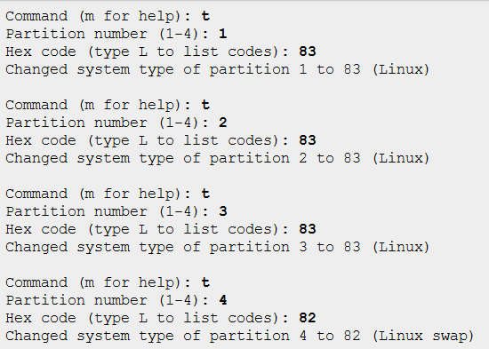

Setting the partition type

Slide 14


Turn on the swap
What after reboot ?
/etc/fstab !

Slide 15

Put a filesystem on the rest
“Implement” the filesystem
What after reboot ?
/etc/fstab !

Slide 16

File system flavors
Ext2
Ext3
Ext2 + journals
Ext4
Ext3 + large file support
XFS
High parallel throughput
FAST !
ZFS
From Solaris => Linux
File checksum, remote replication , …
PETABYTES
ReiserFS
Fast, small files

Slide 17
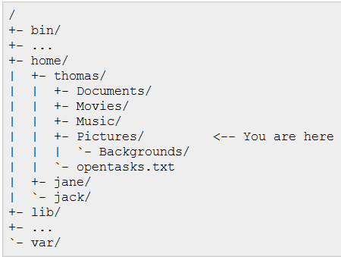
File system concepts
Hierarchically structured tree
Every location has its meaning
Standardized, but variants exist

Slide 18
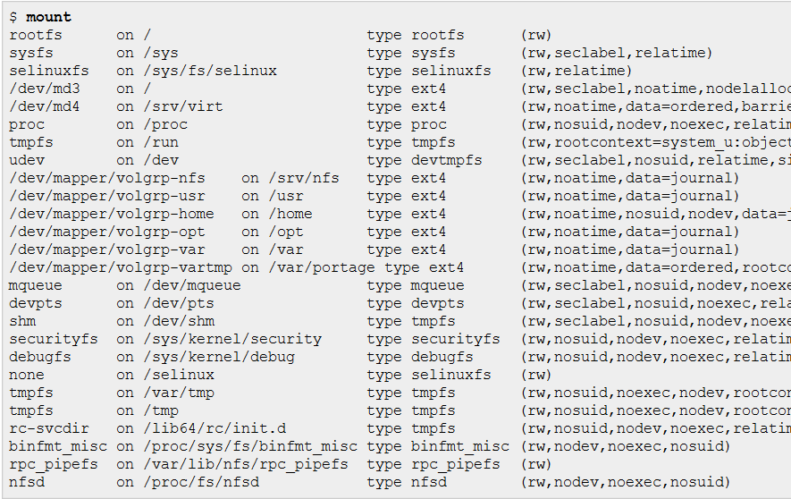
Mount some more

Slide 19
Special partition types
proc
not linked to a device
Pseudo filesystem
gateway to the linux kernel
The kernel talks with you
Through files that can be read / written to

Slide 20
Special partition types
sysfs
Also not linked to a device
Pseudo filesystem
Also a gateway to the linux kernel
So why ????
More structured
Tailored towards computer/software based parsing
⬄ Human based parsing in /proc

Slide 21
Special partition types
tmpfs
Stored in memory
Much faster than even ssd
Data disappears on poweroff
Can still be slow on some occasions
SWAP !
/tmp
/dev/shm
Shared memory
Posix spec
Very application dependent
ORACLE , VMWARE

Slide 22
Special partition types
devtmps
Contains device files managed by the kernel
Solves the chicken and the egg problem : start device on the fly
Provides important device files
before udev (the device manager) is able to start up and take control.

Slide 23
Special partition types
devpts
Pseudo filesystem
Terminal emulation
(xterm, kterm, ssh, telnet…)
Vs “On console”
dummy terminal allocation
BEFOREhand
Hundreds of fixed allocations
/dev/tty
Devpts creates and destroys the device files as they are needed.
Live in /dev/pts/number
You can write to these files !
What do you think happens ?

Slide 24
Special partition types
usbfs
Pseudo filesystem
files are created or destroyed
as USB devices are added or removed from the system
Most USB devices are generic USB devices (belonging to certain classes, like generic USB storage devices)
Linux has developed a framework that allows programs to work with USB devices based on their characteristics, through the usbfs file system.
Deprecated ! All functionality moved to sysfs

Slide 25
Special partition types
nfs
Network filesystem
Allows file systems that are hosted on a remote machine
To be mounted locally
So
/srv/export/systems/remote/disk/users
on machine myhomehost.remotecompany.jp
can be mounted on your LOCAL machine
on /home
mount –F nfs
my..jp:/srv/export/systems/remote/disk/users
/home
(like SMB in windows)

Slide 26
Special partition types
mqueue
Pseudo filesystem
POSIX inter process message queues

Slide 27

Special partition types
selinuxfs
pseudo file system
represents the SELinux subsystem in the Linux kernel.
used by the SELinux libraries
to interact with the SELinux security server
query the SELinux policy
and more
Linux systems that do not have SELinux enabled will not have this file system mounted.
Brought to you by our good friends @

Slide 28


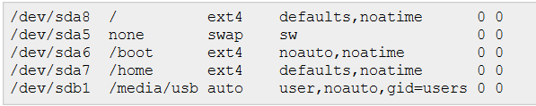

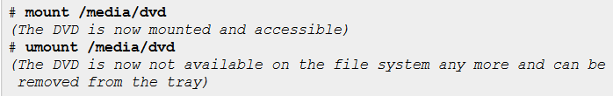
Mount and /etc/fstab
Gone after every reboot…
/etc/fstab makes it permanent
Easy mount & unmount afterwards

Slide 29
/etc/FSTAB in depth
The device to mount
The location to mount the device to (mount point)
The file system type (auto if you want Linux to automatically detect the file system)
Additional options
"defaults" if you don't want any specific option)
noatime (don't register access times to the file system to improve performance)
users (allow regular users to mount/umount the device)
Dump-number
File check order

Slide 30
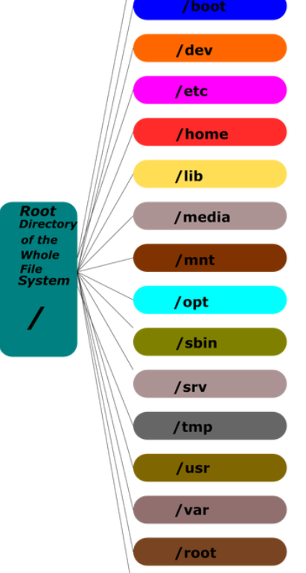
File system system locations
/bin
executable programs needed to run the system
Migration towards /usr/bin and symbolic links for compatibility
/etc
contains all the configuration files for the system
not the user-specific configurations
/lib
system libraries necessary to run the system
to run the commands which are located inside /bin.
also being migrated towards /usr/lib.
/sbin
executable programs to run the system.
/sbin contains programs solely for system administrative purposes
Notes:
You know how Ken Thompson and Dennis Ritchie created Unix on a PDP-7 in 1969? Well around 1971 they upgraded to a PDP-11 with a pair of RK05 disk packs (1.5 megabytes each) for storage. When the operating system grew too big to fit on the first RK05 disk pack (their root filesystem) they let it leak into the second one, which is where all the user home directories lived (which is why the mount was called /usr). They replicated all the OS directories under there (/bin, /sbin, /lib, /tmp...) and wrote files to those new directories because their original disk was out of space. When they got a third disk, they mounted it on /home and relocated all the user directories to there so the OS could consume all the space on both disks and grow to THREE WHOLE MEGABYTES (ooooh!). Of course they made rules about "when the system first boots, it has to come up enough to be able to mount the second disk on /usr, so don't put things like the mount command /usr/bin or we'll have a chicken and egg problem bringing the system up." Fairly straightforward. Also fairly specific to v6 unix of 35 years ago. The /bin vs /usr/bin split (and all the others) is an artifact of this, a 1970's implementation detail that got carried forward for decades by bureaucrats who never question _why_ they're doing things.

Slide 31
File system userland locations
/usr
root of the userland locations
usually the mount point of any separate medium
/usr/X11R(N)
all the files necessary for the graphical window server (X11);
divided in binaries (bin/), libraries (lib/) and header definitions (/include)
for programs relying on the X11 system.
/usr/bin contains all the executable programs
/usr/lib contains all the libraries for the above mentioned programs

Slide 32
File system userland locations
/usr/share contains all the application data for the various applications (such as graphical elements, documentation, ...)
/usr/local
often a separate mount
contain programs specific to the local system
(BUILT &) installed by root
the /usr might be shared across different systems in large environments
“roaming SYSTEM profile”
/usr/sbin
a location for executable programs
contains programs for system administrative purposes only.

Slide 33
File system general locations
/home contains the home directories of all the local users
/boot
contains the static boot-related files
not actually necessary once the system is booted
E.g. bootloader configuration and kernel image
/media
the mount points for the various detachable storage (like USB disks, DVDs, ...)
/mnt
temporarily mounted media
read: not worth the trouble of defining them in fstab

Slide 34
File system general locations
/opt
add-on packages and is usually used to install applications into
which are not
provided by your package manager natively
=>/usr
nor built specific to the local system
=>/usr/local.
/tmp contains temporary files for the system tools.
/var contains data that changes in size, such as log files, caches, etc.

Slide 35

So how do i actually *do* somEthing with a file ???
through the file name
get to the file’s File Control Block (FCB)
using the file system catalog
Commands : Open, Close, Set_Attribute
The system catalog
maps a file name to the FCB
Checks permissions
In C :
file_handle=open(file_name)
search the catalog
bring FCB into the memory (in-core i-node)
Use the FCB to get to the desired offset within the file data
close(file_handle): release FCB from memory

Slide 36
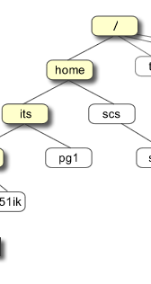
The directories
Files that contain information about other files
A UNIX directory
a file
has an owner, group owner, size, access permissions, etc but their meaning differs slightly (see later)
has an I-node type structure
many file operations can be used on directories
Kernel imposes special structure on it when the command to create it used :
mkdir
whose data is an array or list of (filename, i-node#) pairs.
Data is stored binary (yes, I know…) NOW
They were text once
Performance !

Slide 37
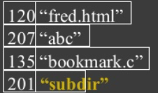
Mkdir at work
Mkdir subdir
Creates a subdir file and an inode for it
The inode and file name are added to the parent file

Slide 38
Files and inodes
Information about each regular local file in a structure called an INODE.
There is 1-to-1 mapping between the INODE and a file.
Multiple files may have the same INODE
Each INODE is identified through its number, a non-negative integer
The INODE hash array is a list of allocated INODE‘s located at the beginning of the file system

Slide 39
Files and inodes
INODE structures (UNIX i-node list)
are stored on the file system block device (e.g., disk)
in a predefined location on the disk. UNIX: the i-node list.
Where it is exactly is file system implementation specific.
INODE numbers have only local meaning (to each file system)
One file system per partition, one INODE table per file system.
Hierarchical structure: Some FCBs are just a list of pointers to other FCBs (i.e. indirection)
to work with a file (through the descriptor interface) the I-node of the file is brought into the main memory as an in-core INODE (V-Node).

Slide 40
Directory structures
is a link between the INODE hash list & the directory files.
The root “/”
INODE is always #2.
directory file data block is located through INODE #2.
Directory file entries include each entry <filename, inode #>
filename is the local (unqualified) directory or filename
inode# is an index into the INODE hash array.
The (inode#) INODE in the hash list entry has a pointer to the data block of the subsequent file or directory file data block.
If a directory
the directory data blocks are read for the next <filename, inode #>
the process repeats.
If a regular file, the data blocks are located and read.

Slide 41
Directory structures
This process also explains the difference between hard links and soft links.
A hard link directory entry is a direct pointer to a file INODE.
A soft link is a pointer to another directory entry.
In a link, rm clears the directory record.
the i-node number is set to 0
the file may not be affected
The file i-node is only deleted
when the last link to it is removed;
the data block for the file is also deleted (reclaimed).

Slide 42
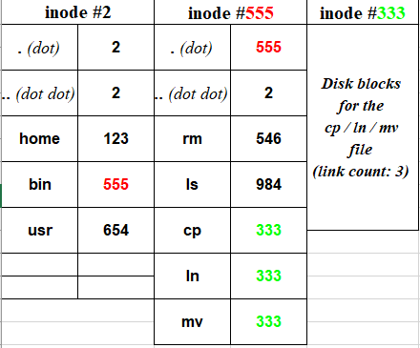
Hard links

Slide 43
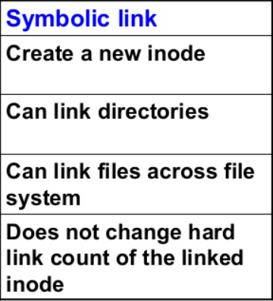
Soft links

Slide 44
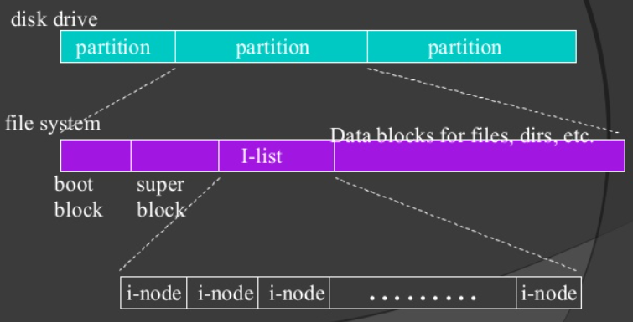
How does all this map to the partition ?

Slide 45
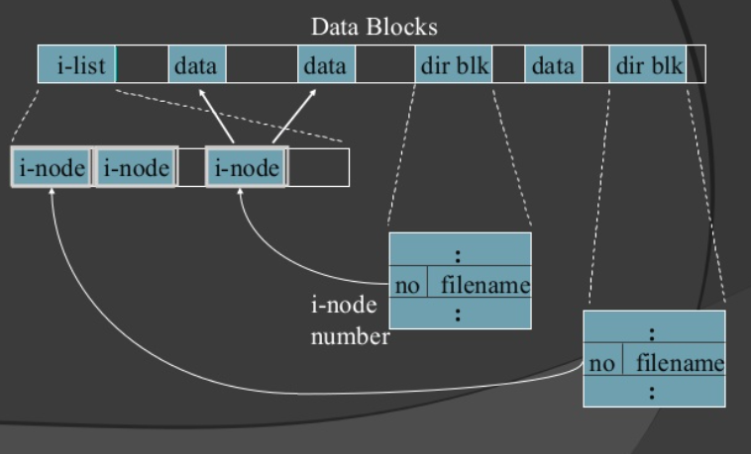
How does all this map to the partition ?

Slide 46

superblock
One per filesystem, contains
Size of the file system
The number of free blocks in the file system
Size of the logical file block
A list of free data blocks available for file allocation
Index of the next free block on the list
The size of I-node list;
The number of free I-nodes on the system;
The list of free INODES on the file system;
The index of the next free I-node on the list.
tune2fs –l /dev/sdax
to display superblock info

Slide 47
Archiving and Compression

Slide 48

Archiving vs. Compression
Archiving collapses multiple files into one
A few files or multiple directories
Compression makes a file smaller
Remove redundant information, replace with a smaller code
Can be applied to individual files, groups of files or entire directory trees

Slide 49
Uses of Archiving and Compression
Managing log files
Sharing groups of files
Project documents
Source code
Compressing for more efficient transfer
Less data to send over the Internet or to tape
Keep like files together grouped by time
Backups

Slide 50
Lossless vs Lossy Compression
Lossless:
Decompressed file is the same as the original
Doesn’t compress as well as lossy
For data you want to preserve
Logs, documents, binaries, configuration
Lossy:
Decompressed file might have lost information from the original
Drops “unimportant” information from the file to make it compress better
Images, sound, movies

Slide 51
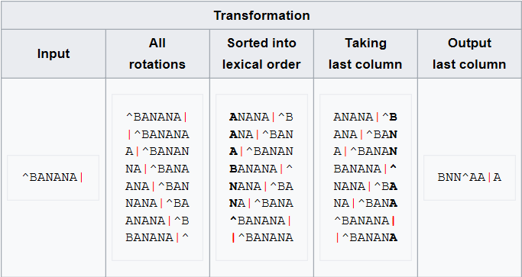
Burrows-wheeler

Slide 52
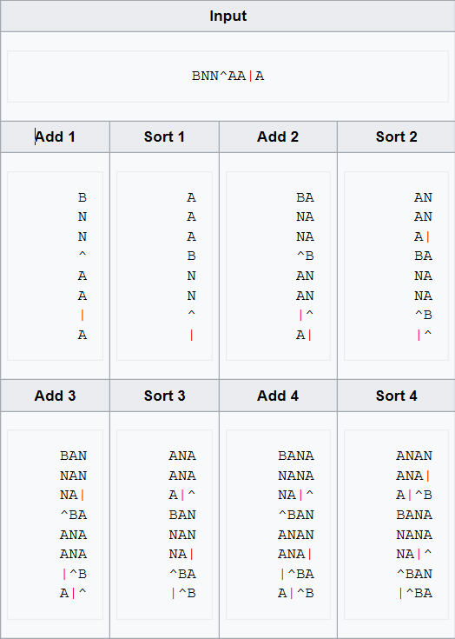
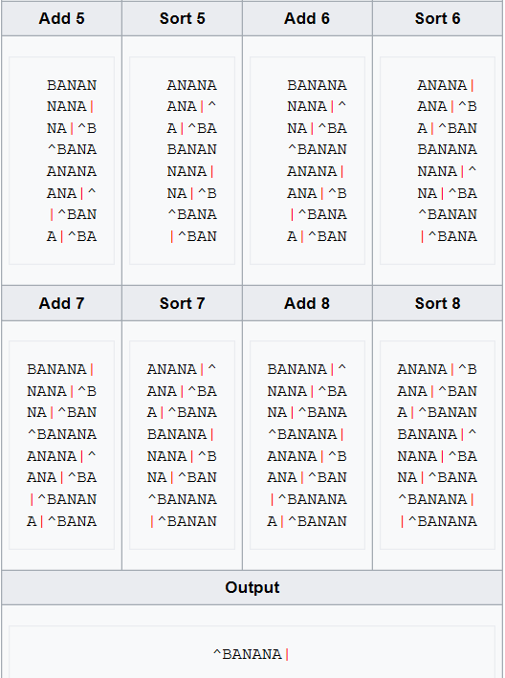
Burrows-wheeler

Slide 53
Using gzip/gunzip/bzip2/bunzip2
gzip foo # removes foo; creates foo.gz
gunzip foo.gz # removes foo.gz; creates foo
gunzip –l foo.gz # shows statistics
bzip2 foo # removes foo; creates foo.bz2
bunzip2 foo.bz2
bunzip2 –l foo.bz2 # DOESN’T EXIST!

Slide 54

Tape Archive - TAR
tar –cf foo.tar * # create
tar –tf foo.tar # show info
tar –xf foo.tar # extract
tar –xf foo.tar home/joe
# only extract home/joe
tar -czf /dev/st0 /home
tar –czf foo.tgz * # gzip
tar –xjf foo.tbz # bunzip2
TARBALL vs TARBOMB

Slide 55
users

Slide 56
User accounts and passwords

Slide 57
User accounts
Files in the /etc directory contain system configuration data.
The /etc/passwd file defines some of the account information for user accounts.

Slide 58
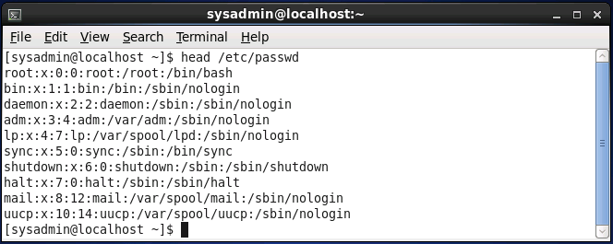
The /etc/passwd file
Each line of the /etc/passwd file relates to a user account.
Each line is separated into fields by colon characters. The fields from left to right are as follows:
name:password placeholder:user id:primary group id:comment:home directory:shell

Slide 59
The /etc/passwd file
Field | Example | Description
name | root | This is the name of the account.
password placeholder | x | The x in the password placeholder field indicates to the system that the password is not stored here, but rather in the /etc/shadow file.
user id | 0 | Each account is assigned a user ID (UID).
primary group id | 0 | When a user creates a file, the file is owned by a group id (GID), the user's primary GID.
comment | root | This field can contain any information about the user, including their real (full) name and other useful information..
home directory | /root | This field defines the location of the user's home directory.
shell | /bin/bash | This is the location of the user's login shell.

Slide 60
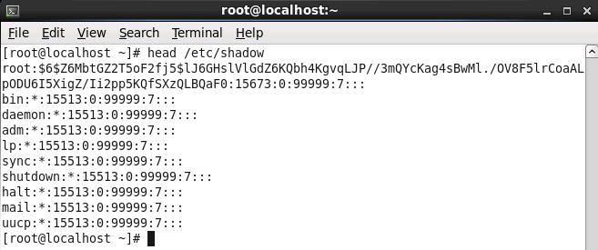
The /etc/shadow file
Contains account information related to the user's password.
The fields of the /etc/shadow file are:
name:password:lastchange:min:max:warn:inactive:expire:reserved

Slide 61
The /etc/shadow file
Field | Example | Description
name | sysadmin | This is the name of the account, which matches the account name in the /etc/passwd file.
password | $6$.........rl1 | The password field contains the hashed password for the account.
last change | 15020 | This field contains a number that represents the last time the password was changed.
min | 5 | The password can't be changed again for the specified number of days.
max | 30 | This field is used to force users to change their passwords on a regular basis
warn | 7 | If the max field is set, the warn field indicates that the user would be "warned" when the max timeframe is approaching.
inactive | 60 | The inactive field provides the user with a "grace" period in which their password can be changed.
expire | 15050 | This field represents the number of days from January 1, 1970 and the day the account will "expire".

Slide 62
Viewing Account Information

Slide 63
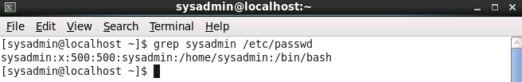
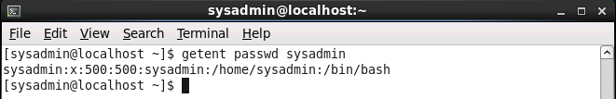
Viewing account information
To see the account information for the user name named "sysadmin", use the grep sysadmin /etc/passwd command:
Another technique is the getent command:

Slide 64
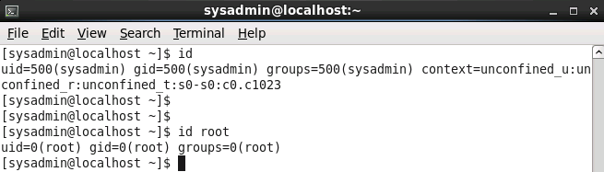
Viewing login information
To verify your identity you can execute the id command:

Slide 65
System Accounts

Slide 66
System accounts
System accounts are designed to provide accounts for services that are running on the system.
Have UIDs between 1-499
Have non-login shells in /etc/passwd
Have * in password field of /etc/shadow
Most are critical for system operation.
Only delete a system account when 100% certain it is not needed.

Slide 67
System Groups

Slide 68
Group accounts
Each user can be a member of one or more groups.
The /etc/passwd file defines the primary group membership for a user.
Supplemental group membership is defined in the /etc/group file.
Either the grep or getent commands can be used to display group information.

Slide 69
The /etc/group file
Each group is defined by this file.
A colon delimited file with the following fields:
group_name:password_placeholder:GID:user_list
Field | Example | Description
group_name | mail | This field contains the group name.
password_placeholder | x | The "x" in this field is used to indicate that the password is stored in the /etc/gshadow file.
GID | 12 | Each group is associated with a unique Group ID (GID) which is placed in this field.
user_list | mail,postfix | This last field is used to indicate who is a member of the group.

Slide 70
Changing groups
Create a file that owned by one of your secondary groups by using:
newgrp group_name
If you’re not a member of the group yet, you’ll need to know the group’s password !
Opens a new shell with new primary group.
Use id command to verify new primary group.
Use exit command to return to previous shell.
May be disabled due to group passwords.

Slide 71
Working with root

Slide 72
Logging in as root
Logging in directly to root account poses a security risk.
Instead, use the su --login or sudo command.

Slide 73
Fun with sudo

Slide 74
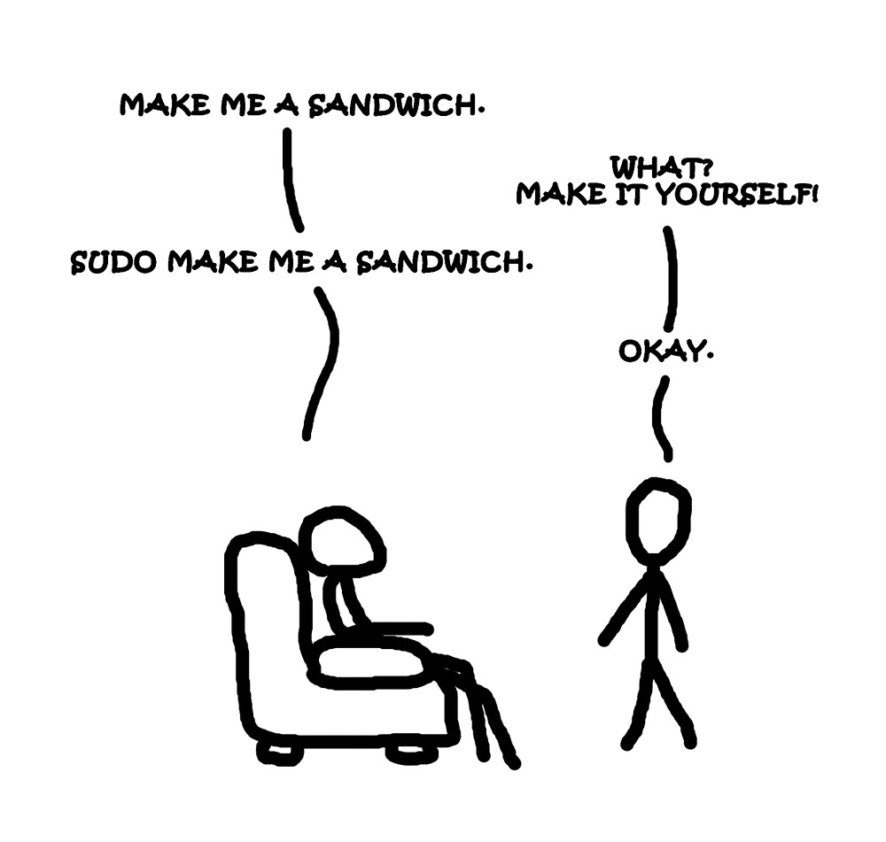

Slide 75
Setting up the sudo command
Configuration is in the /etc/sudoers file.
Modify this file with the visudo command.
Uses vi/vim editors by default.
Use the following to modify default editor:
export EDITOR=nano

Slide 76
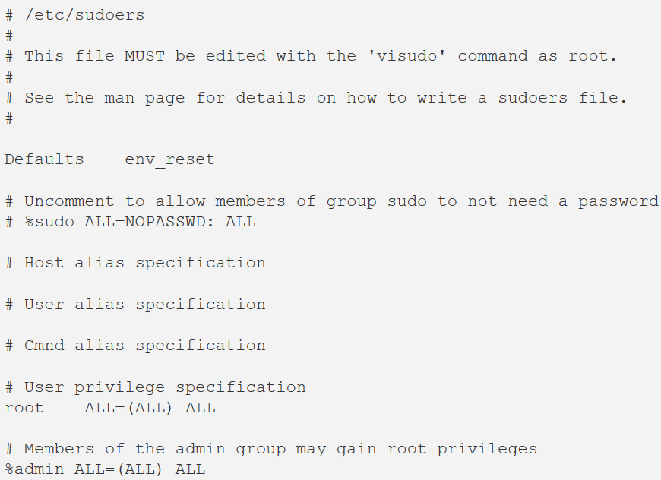
A look inside the /etc/sudoers file
Executed
In
sequence

Slide 77

Look at that line !
(NO)PASSWD:
(NO)EXEC:
(NO)SETENV:
(NO)LOG_INPUT
(NO)LOG_OUTPUT
(NO)MAIL

Slide 78
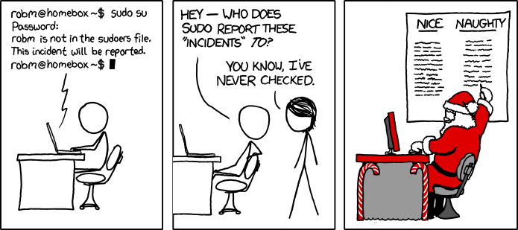

Slide 79
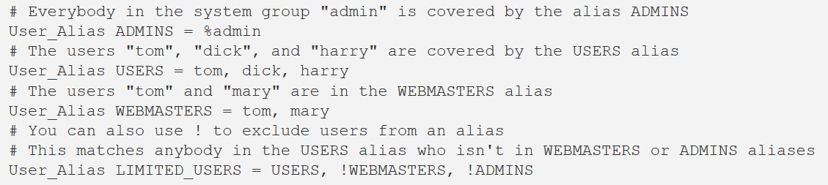
/etc/sudoers : USER ALIASEs

Slide 80
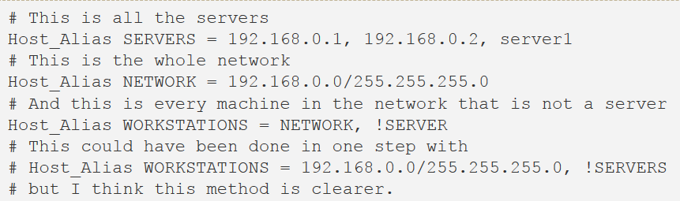
/etc/sudoers : Host ALIASEs

Slide 81
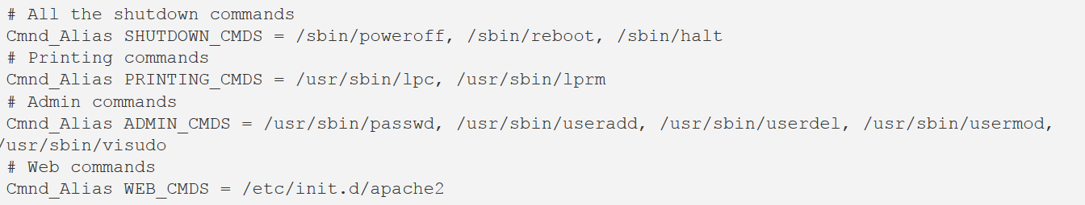
/etc/sudoers : Command ALIASEs

Slide 82
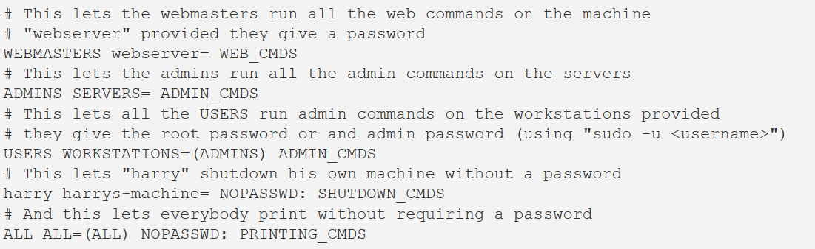
/etc/sudoers : Bringing it all together

Slide 83
who and w Command

Slide 84
Using the who command
Displays a list of users who are currently logged in:
[sysadmin@localhost ~]$ who
root tty2 2013-10-11 10:00
sysadmin tty1 2013-10-11 09:58 (:0)
sysadmin pts/0 2013-10-11 09:59 (:0.0)
sysadmin pts/1 2013-10-11 10:00 (example.com)
Column | Example | Description
username | root | Name of the user who is logged in.
terminal | tty2 | This column indicates which terminal window the user is working in.
date | 2013-10-11 10:00 (example.com) | This indicates when the user logged in.

Slide 85
Using the w command
Displays detailed user and system information:
[sysadmin@localhost ~]$ w
10:44:03 up 50 min, 4 users, load average: 0.78, 0.44, 0.19
USER TTY FROM LOGIN@ IDLE JCPU PCPU WHAT
root tty2 - 10:00 43:44 0.01s 0.01s -bash
sysadmin tty1 :0 09:58 50:02 5.68s 0.16s id
sysadmin pts/0 :0.0 09:59 0.00s 0.14s 0.13s who
sysadmin pts/1 example.com 10:00 0.00s 0.03s 0.01s w

Slide 86
Using the w command
Column | Example | Description
USER | root | This column indicates the name of the user who is logged in.
TTY | tty2 | This column indicates which terminal window the user is working in.
FROM | example.com | Where the user logged in from.
LOGIN@ | 10:00 | When the user logged in.
IDLE | 43:44 | How long the user has been idle since the last command they ran.
JCPU | 0.01s | The total cpu time (s=seconds) used by all processes (programs) run since login.
PCPU | 0.01s | The total cpu time for the current process.
WHAT | -bash | The current process that the user is running.

